Slide 1
ADF
AutoDealerForce

Slide 2
This Project is developed for different car Dealers.

Slide 3
Here we are managing all the dealer sites using one backend engine, that is ADF.
This backend provides all data to the frontend dealer sites.
All data are stored one common database (autodealerforce_live_db).
Currently there are 9 dealer sites and more than 10 brands are under ADF.

Slide 4
Dealers
Westend Motor Group
Pearson
Brown Brothers Peebles
PV Dobson
Henrys Cars
JC Campbell, Newry in Northern Ireland
North Wales Honda
McCreath And Son
Greenacrehonda
Brands
CITROËN
Dacia
Honda
Isuzu
Mazda
Mitsubishi
Renault
ŠKODA
SsangYong
Suzuki
Volvo

Slide 5
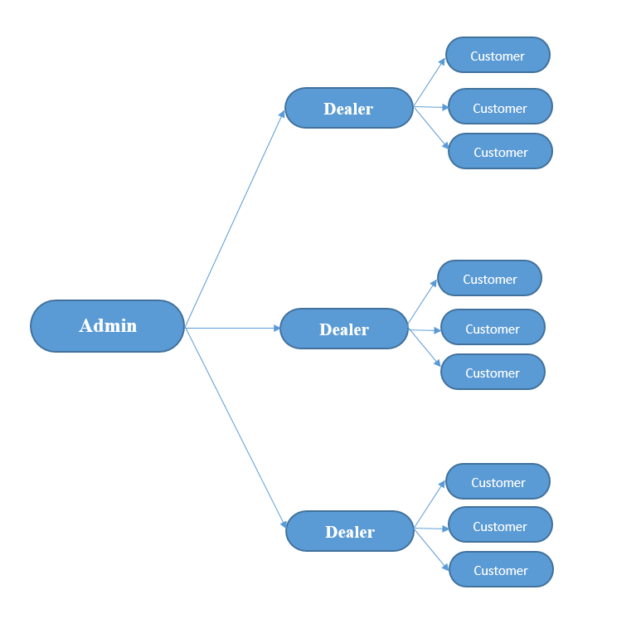
Users
Admin
Dealers
Customers

Slide 6
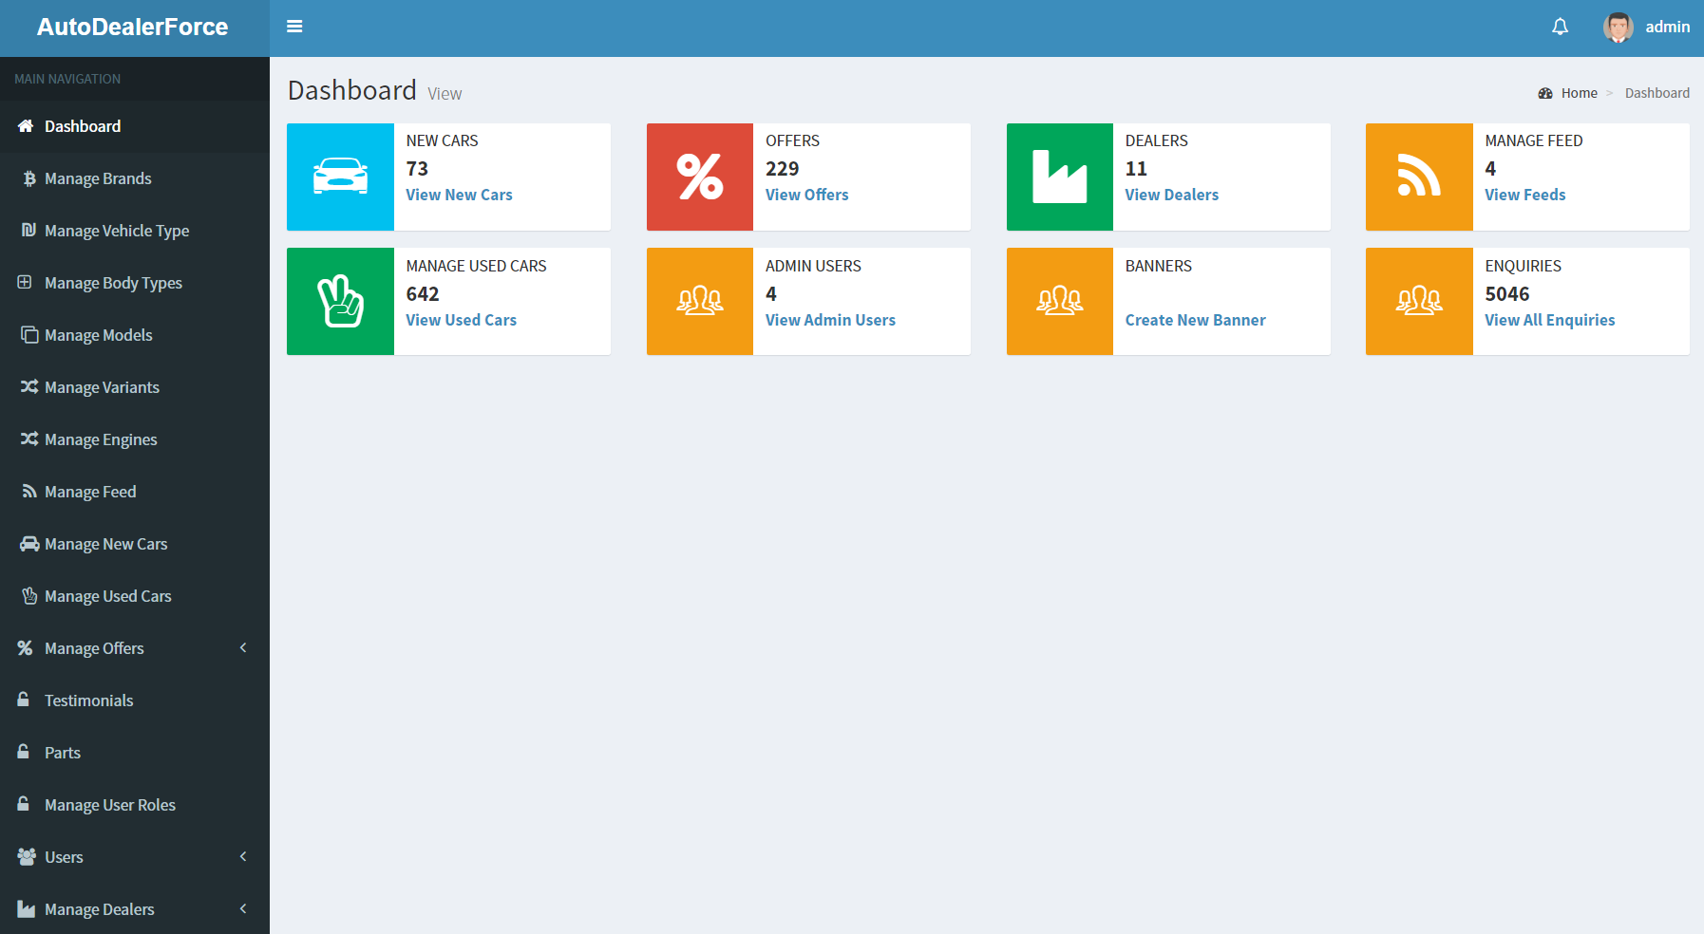
Backend (Admin)

Slide 7
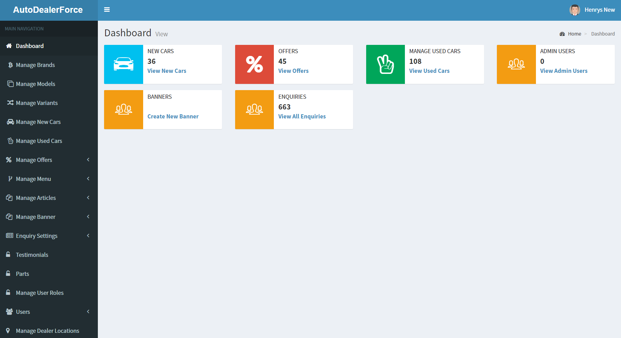
Backend (dealer)

Slide 8
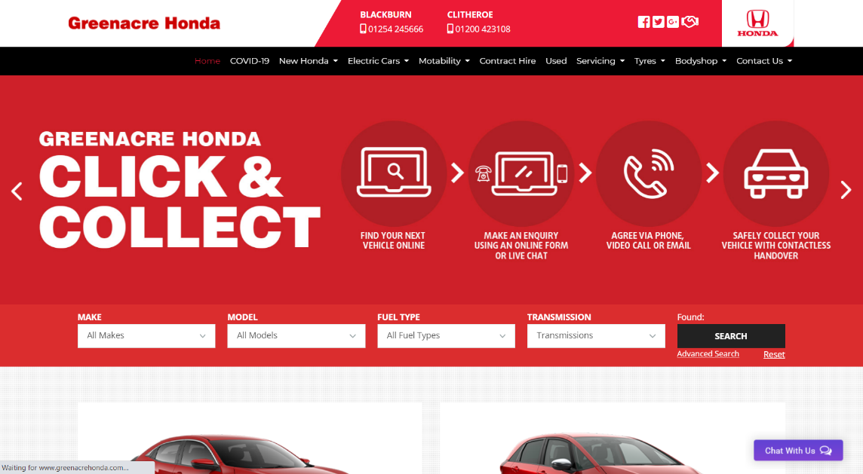
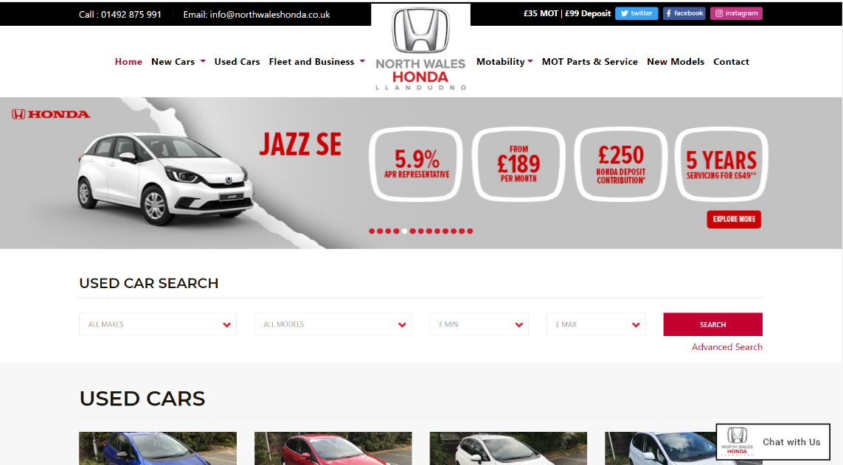
Frontend (dealer sites e.g.)

Slide 9
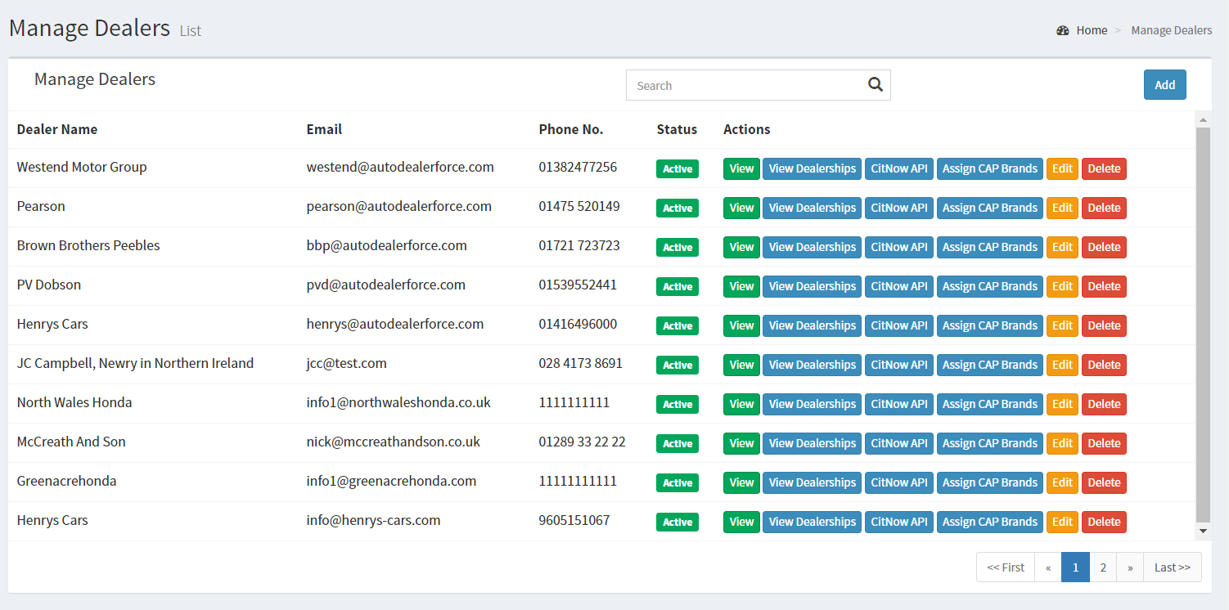
Admin add dealers and create admin users. So that the dealer can access the backend of their site.

Slide 10
Like wise Admin can add and manage :
Brands
New Cars
Offers
Used Cars
Services
Service Offers

Slide 11
Banners
Testimonials
Articles
Menus
Themes etc.
Dealers can also add and update these data from their individual backend.
The changes will automatically updated in sites…

Slide 12
And there are some forms in Enquiry Settings for :
Book A Service
Vehicle Enquiry & General Enquiry
Contact Us
Book A Test Drive
Value My Car
Request a Brochure

Slide 13
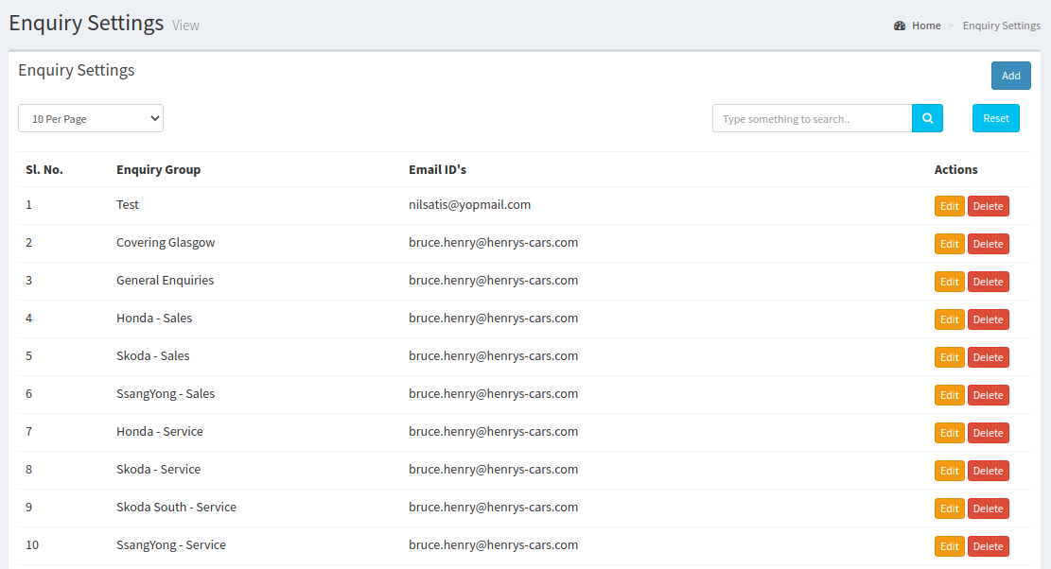
The Form data will directly send to the Email IDs that we already assign with corresponding forms.

Slide 14
Source Code
Controller
Back
Front
Model
Common Model
View
Backend
Frontend
Diffrent dealers
Database
One Common DB
autodealerforce_live_db

Slide 15
Thank You…

